Slide 1

E-COMMERCE INDUSTRY
Here is where your world of shopping begins….

Slide 2
Contents
INTRODUCTION
1
E-commerce
Team
3
2
Overview
5
4
Sap & E-commerce
Integration
Pros & Cons
6
conclusion

Slide 3

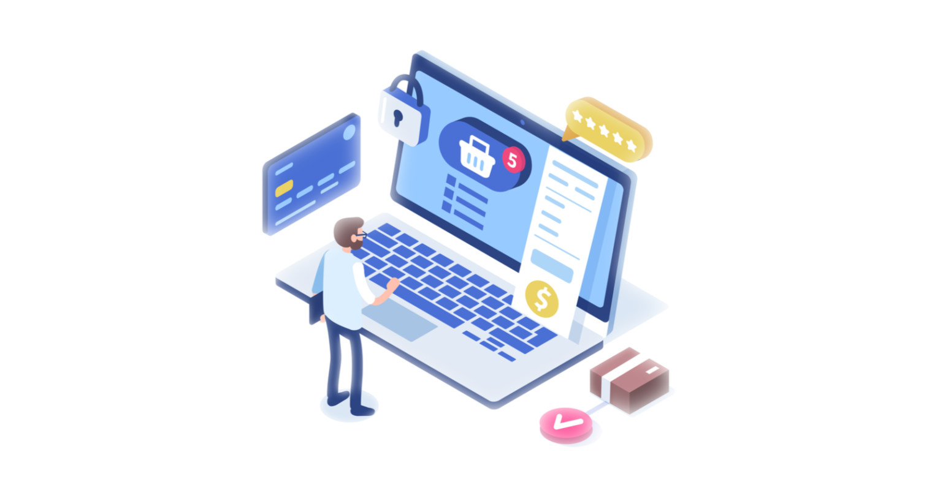
E-Commerce
Ecommerce (or electronic commerce) is the buying and selling of goods (or services) on the internet. It encompasses a wide variety of data, systems, and tools for online buyers and sellers, including mobile shopping and online payment encryption.

Slide 4
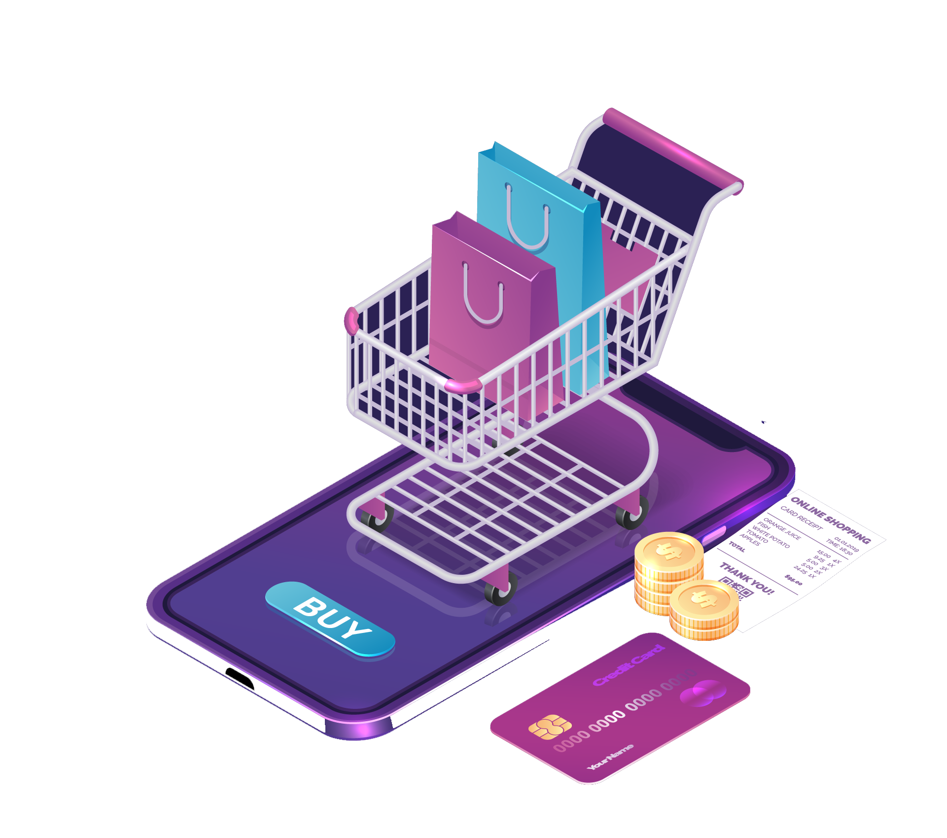
Why E-commerce ?
E-commerce is a huge part of the economy and is vital to businesses that sell their products or services online. E-commerce gives businesses the ability to reach more customers than traditional retail. With so many people making their purchases online, it is the fastest-growing retail market.

Slide 6
When it all began !!!
1982
1995
2007
Boston Computer Exchange
Amazon
Flipkart
1969
1992
1999
2009
CompuServe
Alibaba
BigCommerce
Book Stacks

Slide 8
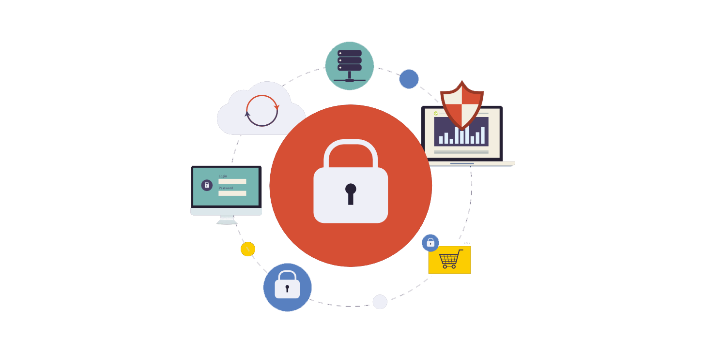
Is E-commerce Safe !
“Yes, ecommerce is safer than ever before.”
With the help of multi-layered ecommerce security, monitored transactions, regular PCI scans, SSL certification, protection against DoS/DDoS attacks, and hosting solutions that are PCI compliant, ecommerce stores can offer shoppers the peace of mind that their online purchases are made in a safe and secure environment.

Slide 9
Features of E-commerce
Easy to Use
Simple navigation tools, easy checkout flows, etc.
Compatibility
Compatible and functional on all mobile devices.
Security
Payment processing is secure and reliable.
Social Proof
Validation from past customers and trusted sources.
User Intent
Reviews, ratings and photos that add to the ethos of offerings.

Slide 10

Types of E-Commerce
B2C
B2C ecommerce encompasses transactions made between a business and a consumer.
B2B
B2B ecommerce encompasses sales made between businesses, such as a manufacturer and a wholesaler or retailer.
C2C
Customer-to-customer relates to the sale of products or services between customers.
C2B
C2B makes individual consumers make their products or services available for business buyers.
B2A
B2A covers the transactions made between online businesses and administrations.
C2A
C2A is similar to B2A, but consumers sell online products or services to an administration.

Slide 11

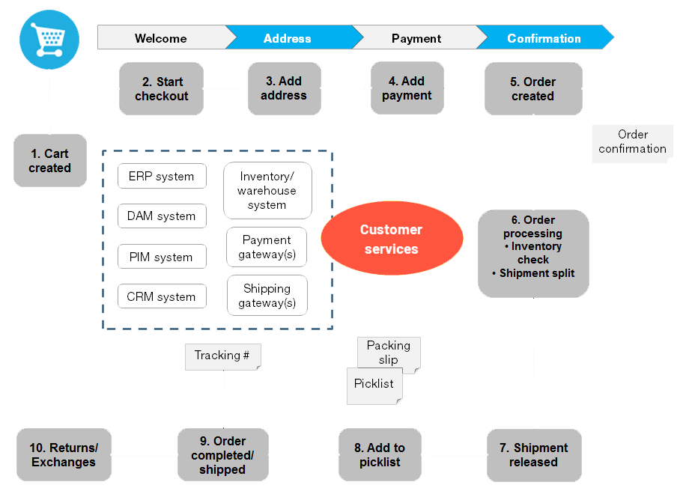
B2C Shopping Flow

Slide 12
E-commerce Management Flow
E-commerce
Administration
Production
Merchandising
Marketing
Accounting
Support
BOD’s
Chief Officers
Finance
Logistics
HR’s etc
Project Managers
System Admin
Development
Clients
R& D
Buyers
Inventory Planners
Merchandisers
Advertisers
CAP Managers
CRP Managers
Event Managers
Social Media
Branding & Design
Auditors
Lawyers
Banking Mentors
Taxing Management
Service Managers
Mentors
Service Agents

Slide 13

01
ADMINSTRATION

Slide 14

Administration
The Administration department has the responsibility of ensuring that the administrative activities within an organization run efficiently by providing structure to other employees throughout the organization. These activities can range from being responsible for the management of human resources, budgets and records, to undertaking the role of supervising other employees. These responsibilities can vary depending on the employer and level of education.

Slide 15

02
PRODUCTION TEAM

Slide 16

Production Team
R&D represents the activities companies undertake to innovate and introduce new products and services or to improve their existing offerings.
A Production team is a group of people that work together to create software. This is complex, creative work that requires adaptability as technical challenges arise and business requirements evolve

Slide 17

03
MERCHANDISING

Slide 18

Merchandising
eCommerce merchandising is a strategy of organizing, structuring, and standardizing the products and offers on an online website with the purpose to increase sales. This method often includes promotions, increasing search results, and mainly focusing on overall needs and customer satisfaction.

Slide 19
04
MARKETING

Slide 20

Marketing
Ecommerce marketing is the practice of using promotional tactics to drive traffic to your online store, converting that traffic into paying customers, and retaining those customers post-purchase. ... You can use ecommerce marketing to promote your online store as a whole or to drive more sales for specific products.

Slide 21

ACCOUNTING TEAM
05

Slide 22

Accounting
Ecommerce accounting refers to collecting, analyzing, organizing, and reporting financial data related to business transactions and assets within an ecommerce business.
All the financial information that ecommerce entrepreneurs obtain via these procedures are valuable foundations for making future business decisions.

Slide 23

CUSTOMER SUPPORT
06

Slide 24

Customer Support
Customer service teams are focused on providing the best possible customer experience and continuing customer relationships once a product is sold. They also specialize in customer retention and solve complex issues frustrating customers. The customer service team is the face of the company, the front-line when customers contact a business for assistance. Customer service agents help consumers pay bills, review or make changes to accounts, handle returns and answer frequently asked questions.

Slide 25

SAP & E-COMMERCE INTEGRATION
SAP is one of the most popular software solutions for complex tasks such as supply chain management. To make the software more productive, ecommerce businesses can have it integrated into their front end, providing a way to get the most out of every part of their overall software solutions.

Slide 26
Global ERP Market Share

Slide 27
Impact of E-commerce
Large retailers are expanding buy selling online.
The rise of ecommerce marketplaces.
Supply chain management has evolved
E-commerce sell products directly to the customers
Customers shop differently.

Slide 28

Advantages
Disadvantages
Faster buying/selling procedure, as well as easy to find products. Buying/selling 24/7
Limited interactions with customers
More reach to customers, there is no theoretical geographic limitations.
Technology breakdowns can impact ability to sell
Low operational costs and better quality of services No need of physical company set-ups.
No ability to test or try on.
Easy to start and manage a business
Lack of touch or feel of products during online shopping is a drawback
There is the possibility of credit card number theft. Jurisdiction issues in cyberspace.
Customers can easily select products from different providers without moving around physically.

Slide 29

2,148,300,000+
Global E-Commerce Users
Almost 27.6 percent of world population are digital buyers in 2021

Slide 30
We’ve looked at all corners of ecommerce, including its different types, the history, how it's grown over the years, and its impact on consumers and how business is conducted.
There are certainly advantages and disadvantages to ecommerce, but the future has many opportunities for even greater expansion.
Future is
E-Commerce

Slide 31


Slide 32


TEAM - B
Thank you
By
U. Santhosh Vara Prasad
G. Premchandu
P. Dakshayani

